Slide 1
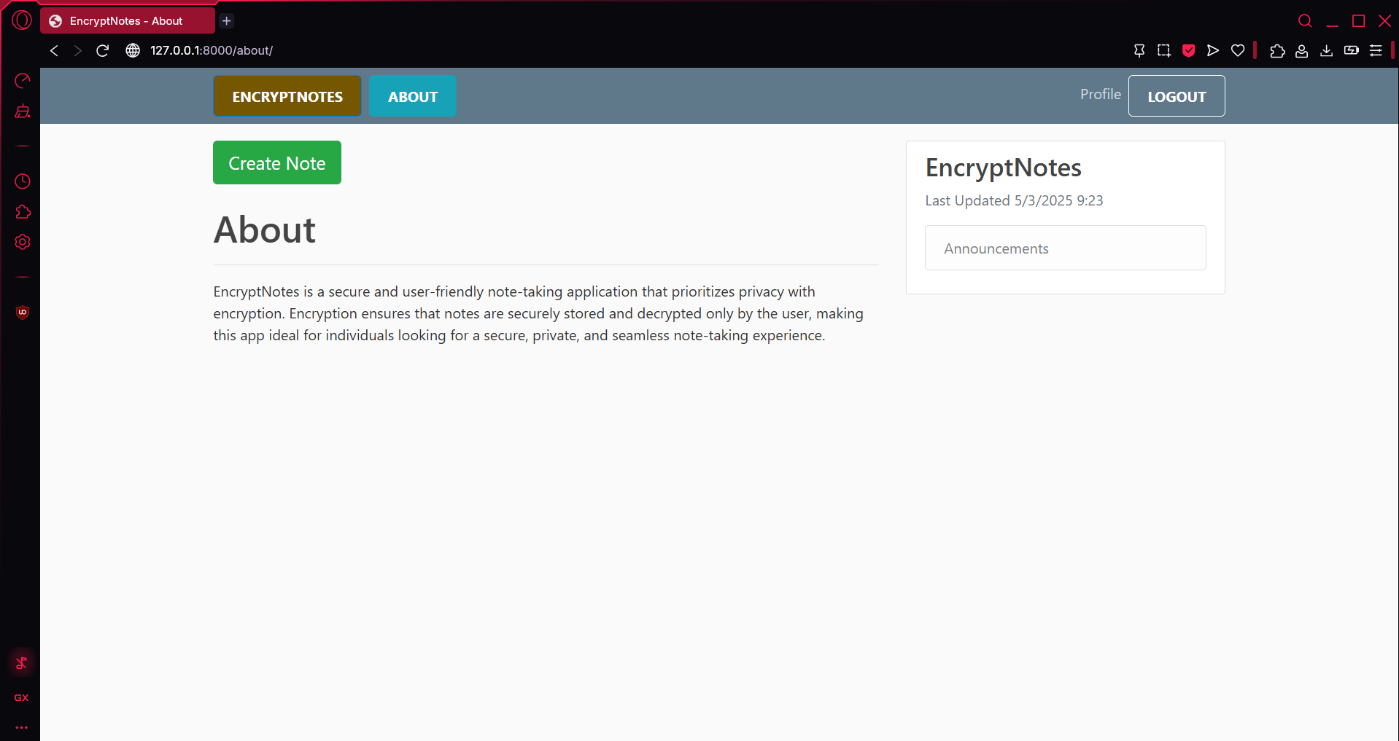
EnCryptNotes
Team 2

Slide 2

What is it?
EncryptNotes is a Note Taking Web-Application
It Secures every Note you make
It put multiple layers on it, so it most secure it can be

Slide 3

Why a Website?
It’s a website, because we thought it was the best place to have
No, downloading needed
It allows for easy access
It gave us a good environment to develop and create our application

Slide 4
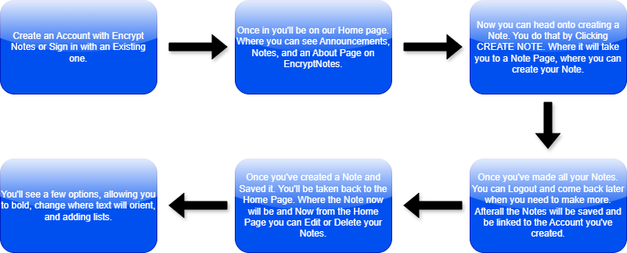
So How Do You Use It?

Slide 5

Who would use it?
There isn’t really a specific type of person we are targeting
Anyone can use it Young, Old, Woman, Man
If anyone it’s those who like to be safe and secure with their information

Slide 6
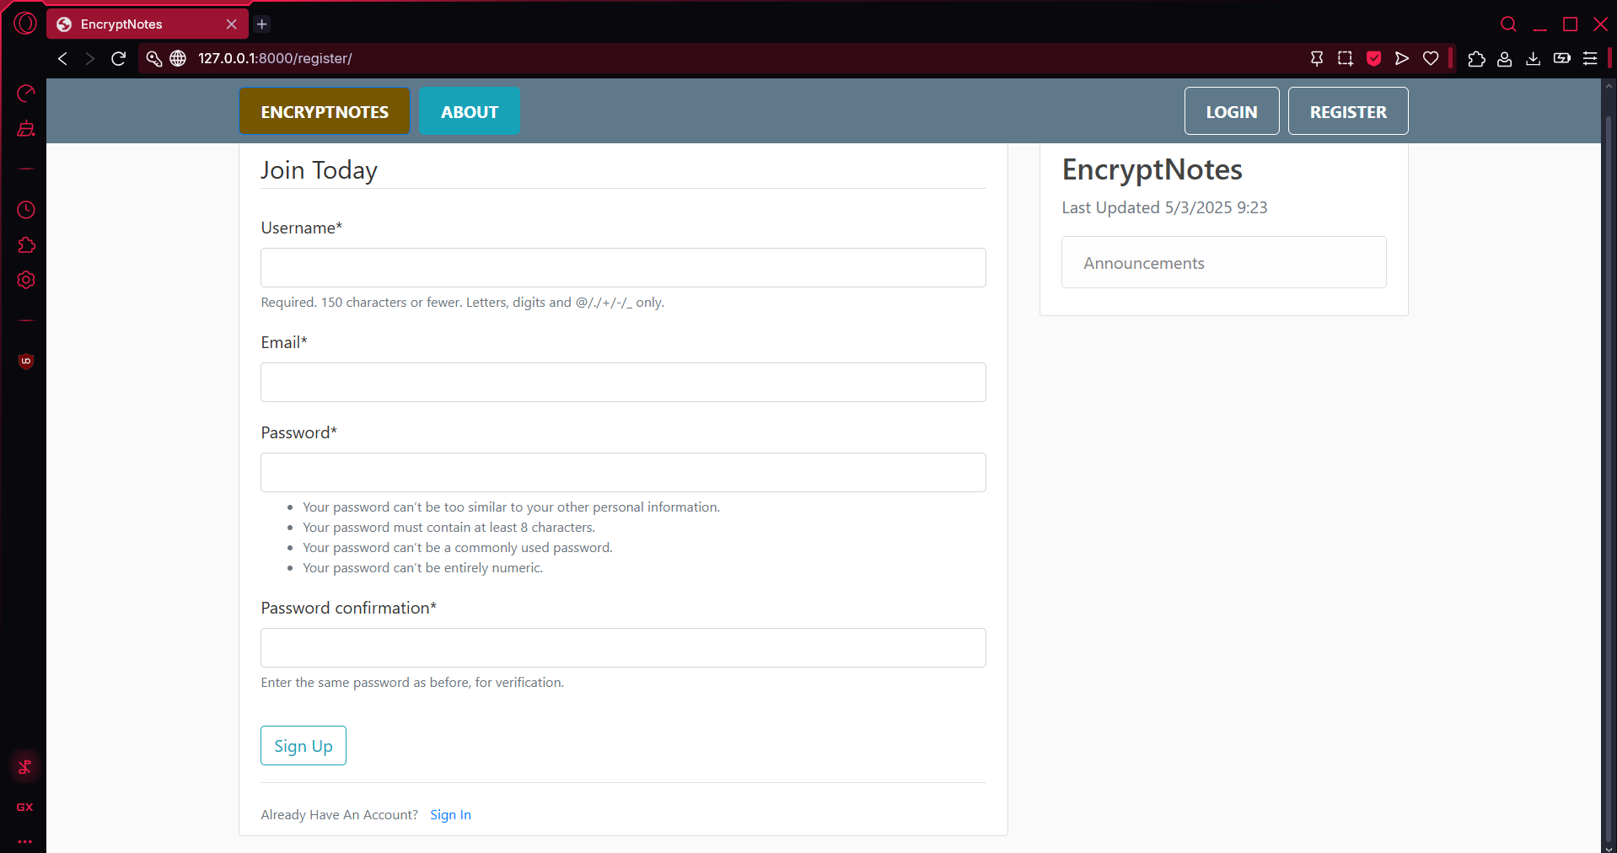
Sign up page
Here is an Image of the first step in the, How Do You It? Flow Chart.
User Creation

Slide 7
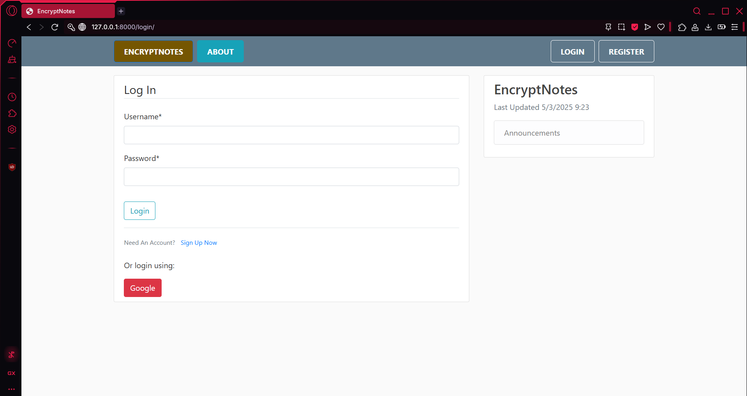
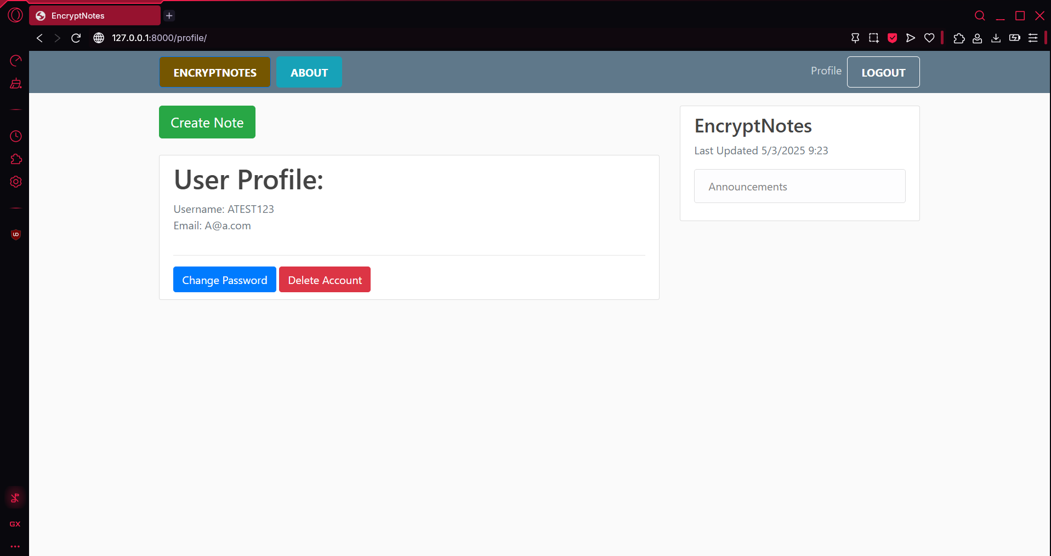
Login/profile page
Here is an Image of the second step.
This is showing the Login page and User page once Logged in.

Slide 8
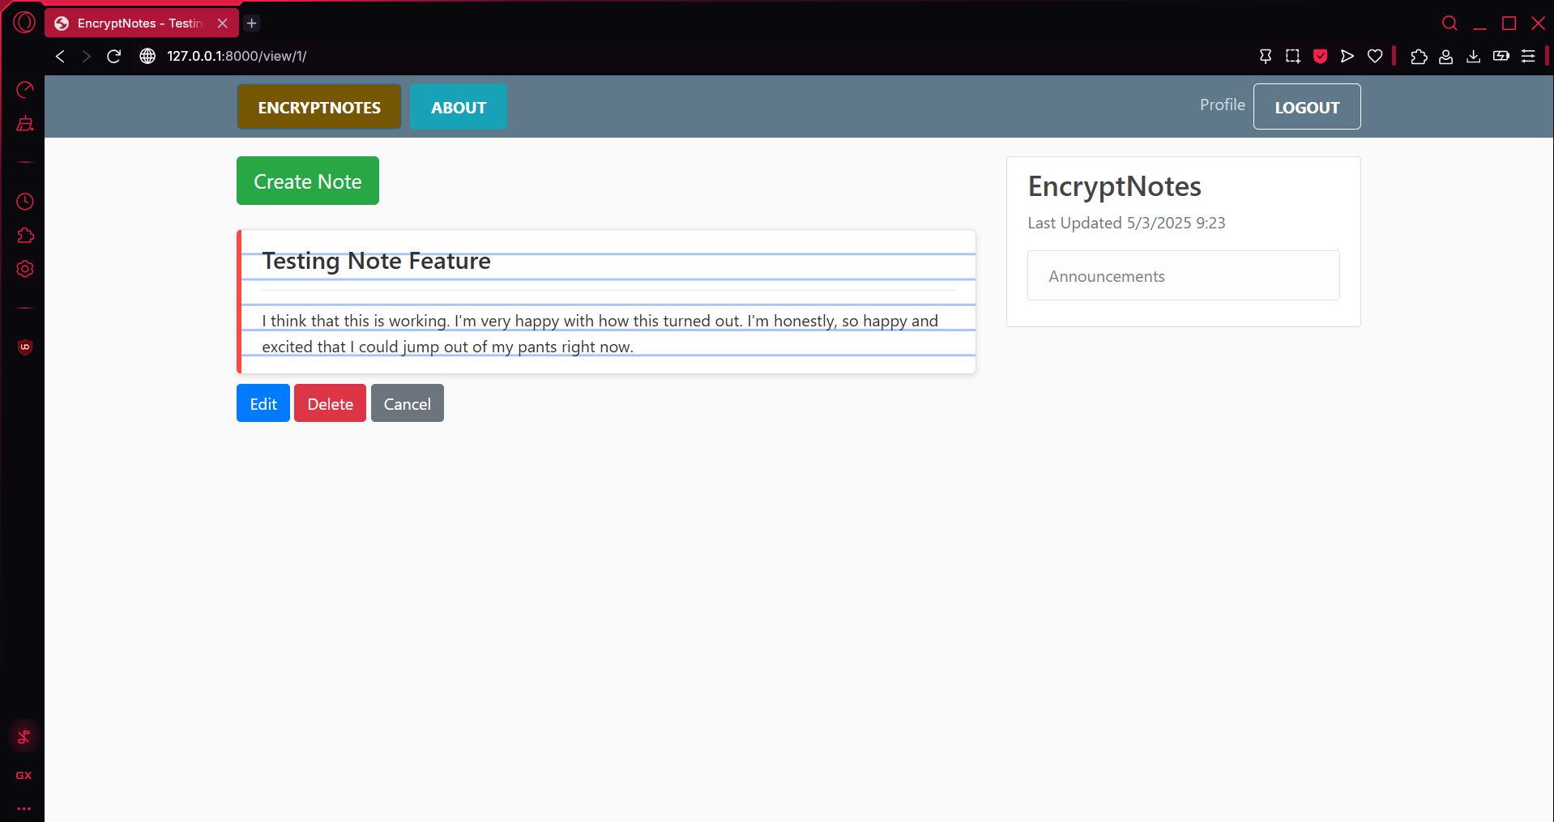
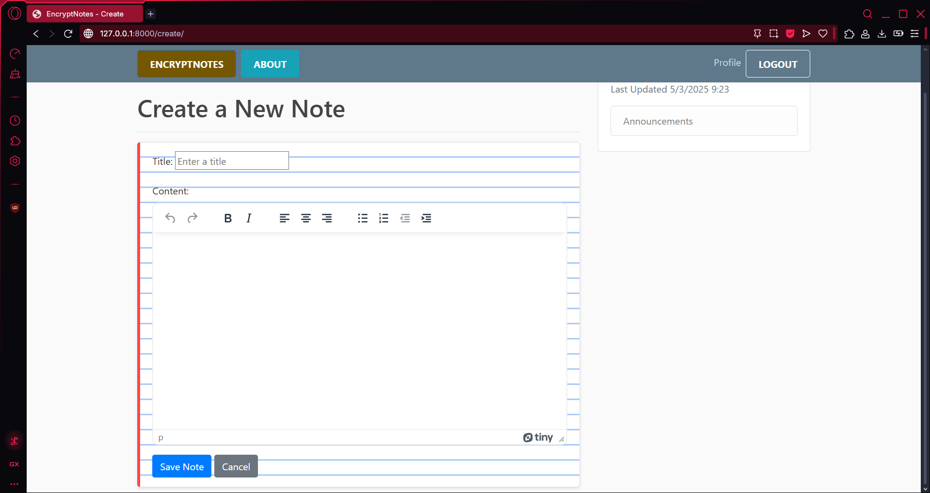
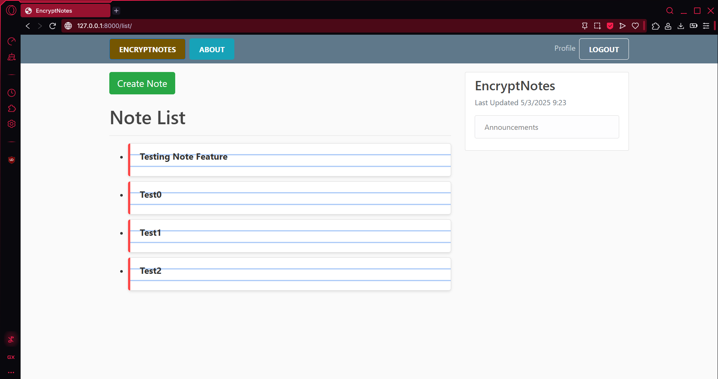
Note Pages

Slide 9
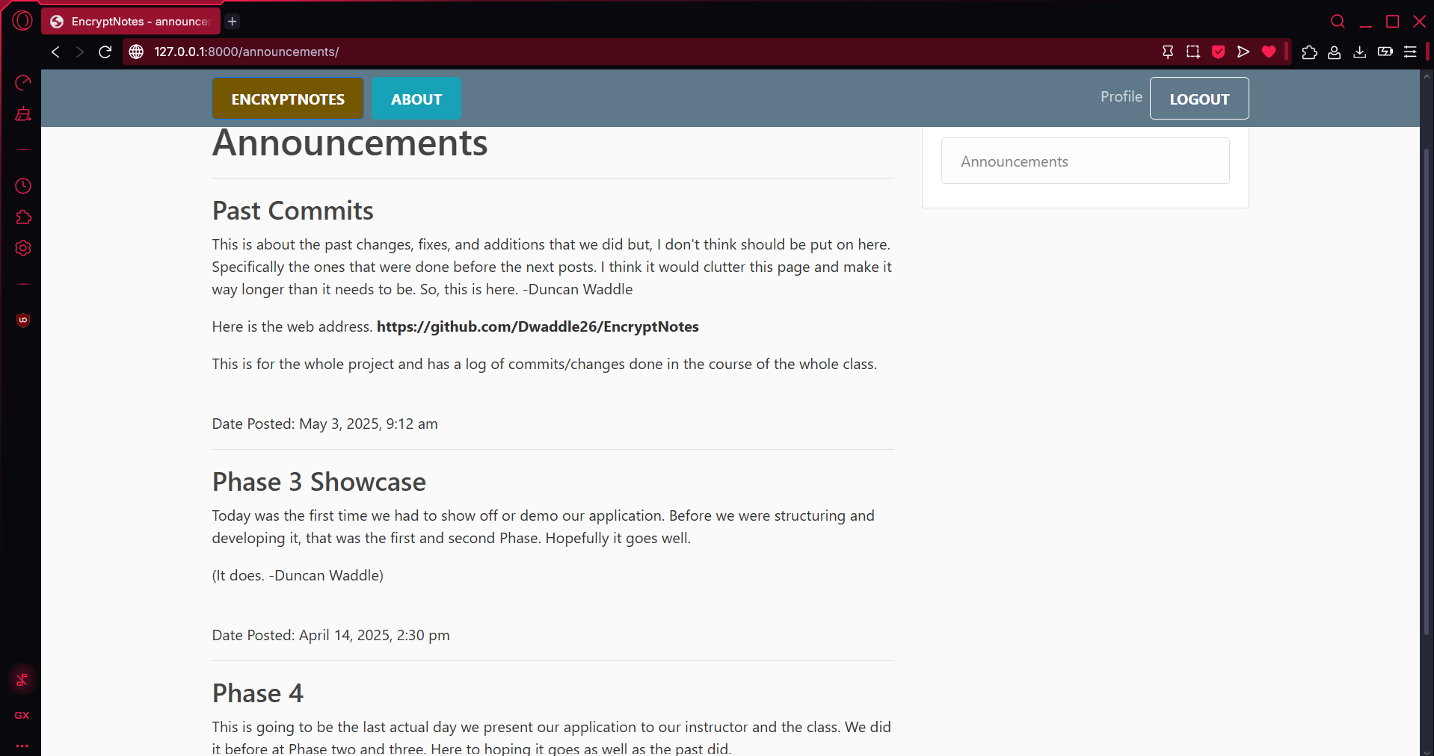
Announcements

Slide 10
Live Demo

Slide 11
Questions?

